Slide 1



Slide 2

Project Mentor:
Snehal Shinde
Project Co-Ordinator:
Sunkarapalli Mounika
Group - I Members:
Ms. Vangeti Bhavana
Mr. Vijaykumar V Dalali
Kanchan kag
Arya Krishna A
Agath Clafio
Nemalipuri Rakesh
Vineeth PM

Slide 3

Purpose: The bankruptcy prevention projects is the probability that a business goes bankrupt or not from different features.
Key Attributes:
The data file contains 7 features about 250 companies including the following variables:
Industrial_risk: 0=low risk, 0.5=medium risk, 1=high risk.
management_risk: 0=low risk, 0.5=medium risk, 1=high risk.
financial flexibility: 0=low flexibility, 0.5=medium flexibility, 1=high flexibility.
credibility: 0=low credibility, 0.5=medium credibility, 1=high credibility.
competitiveness: 0=low competitiveness, 0.5=medium competitiveness, 1=high competitiveness.
operating_risk: 0=low risk, 0.5=medium risk, 1=high risk.
class: bankruptcy, non-bankruptcy (target variable).

Slide 4

Analysis
Import Libraries and Load Data
Explore the Data
Visualize Data Distributions

Slide 5

Import Libraries
#Start by importing the necessary libraries
#EDA Part
import pandas as pd
import numpy as np
import matplotlib.pyplot as plt
import seaborn as sns
from sklearn import preprocessing
import sweetviz as sv
from sklearn.model_selection import train_test_split, GridSearchCV
from sklearn.metrics import classification_report, confusion_matrix, roc_auc_score, roc_curve, precision_recall_curve, average_precision_score
from sklearn.preprocessing import StandardScaler
from imblearn.over_sampling import RandomOverSampler
import pickle

Slide 6

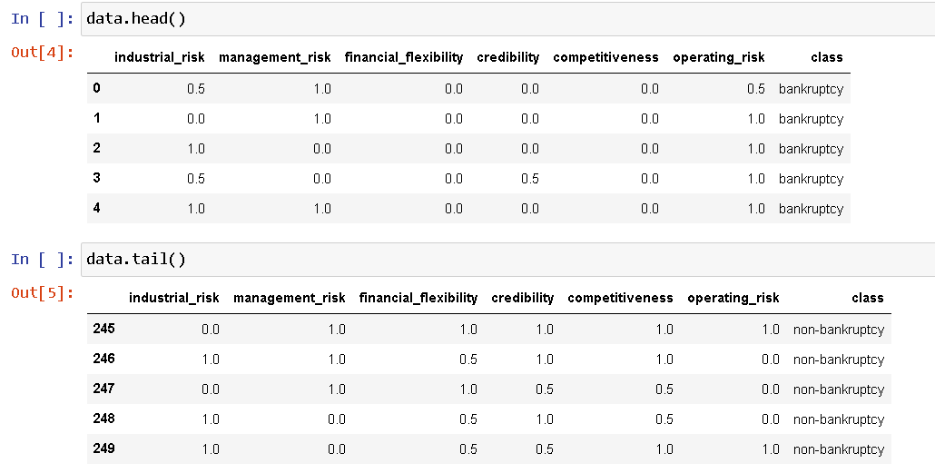
Load Data
# Load your dataset into a Pandas Data Frame
data=pd.read_excel("/content/bankruptcy.xlsx")

Slide 7

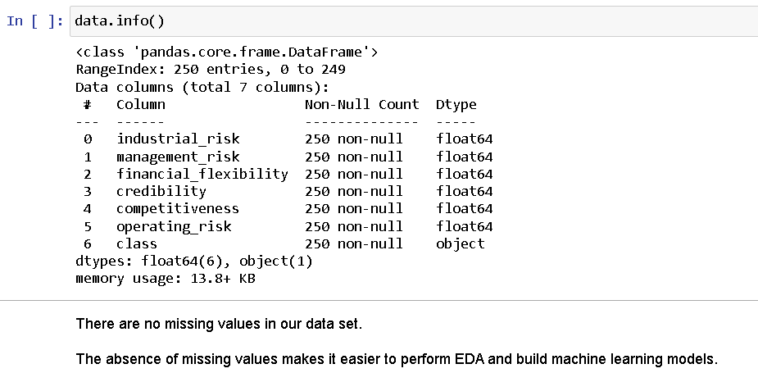
Explore the Data

Slide 8
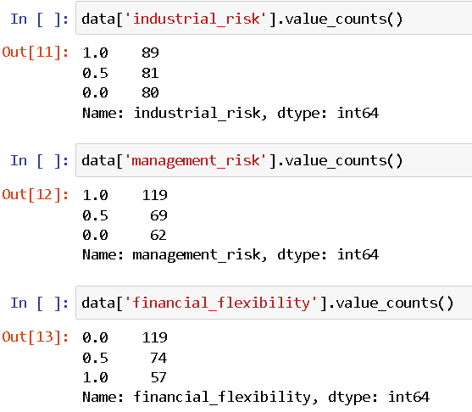
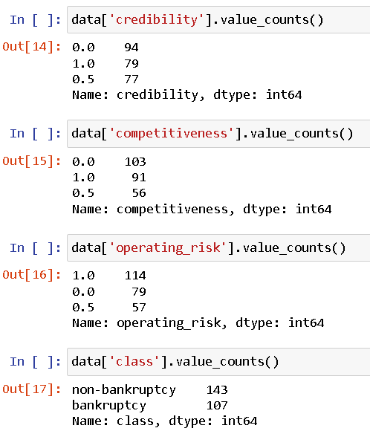
Value Counts

Slide 9
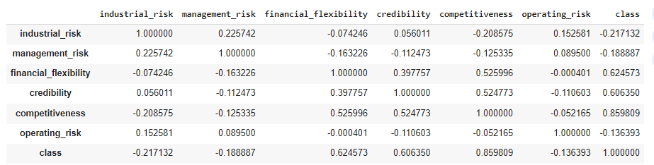
Correlation Analysis
data.corr()
Correlation Analysis helps to understand how changes in one variable are associated with changes in another.
Here the feature industrial_risk, management_risk and operating_risk is having a negative correlation with the target variable "class" whereas the features financial_flexibility credibility and competitiveness shares a strong positive correlation.

Slide 10
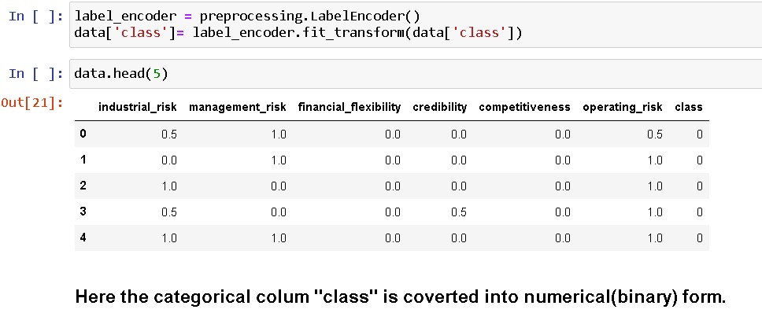
Label Encoding

Slide 11

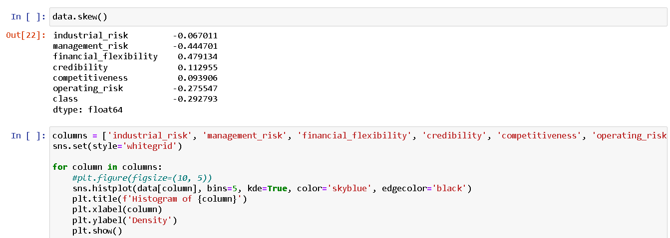
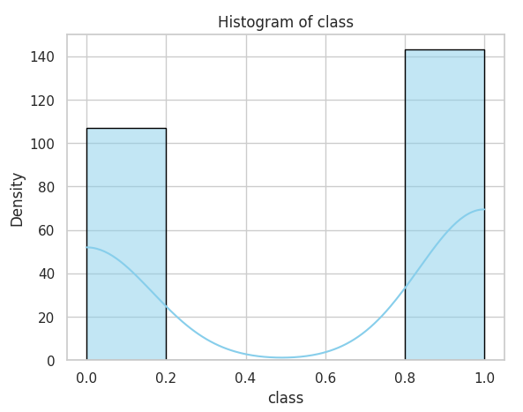
Visualize Data Distributions

Slide 12
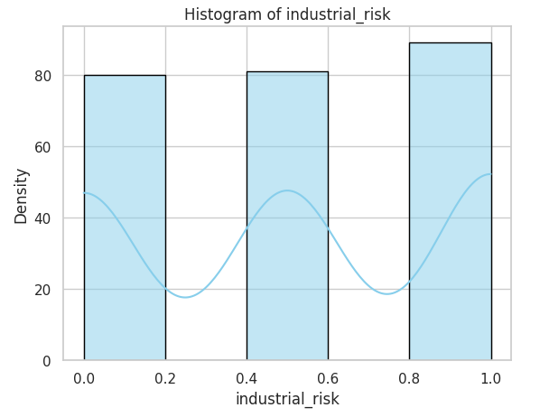
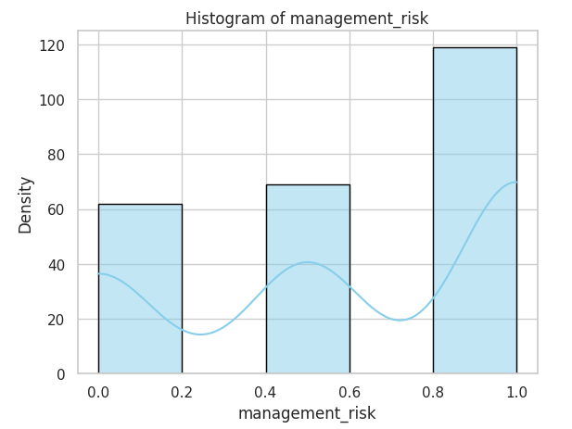
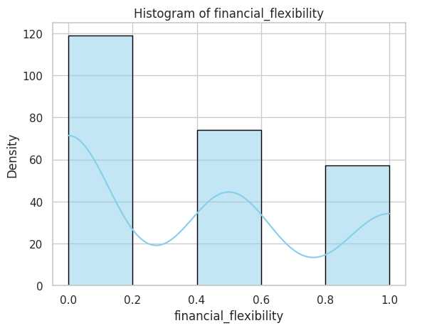
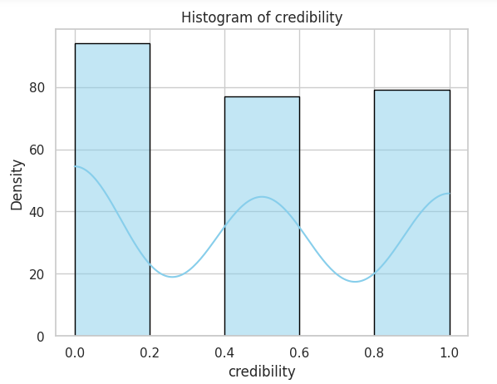
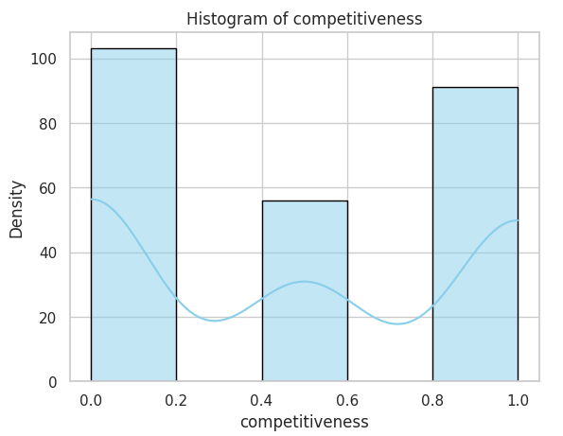
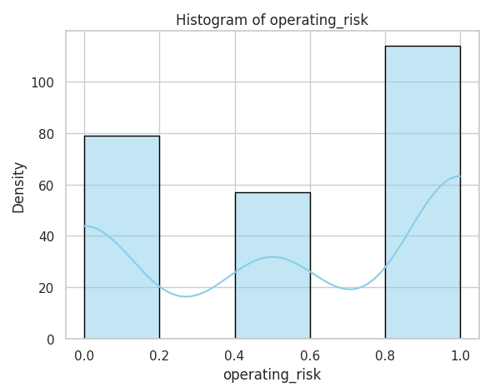

Slide 13
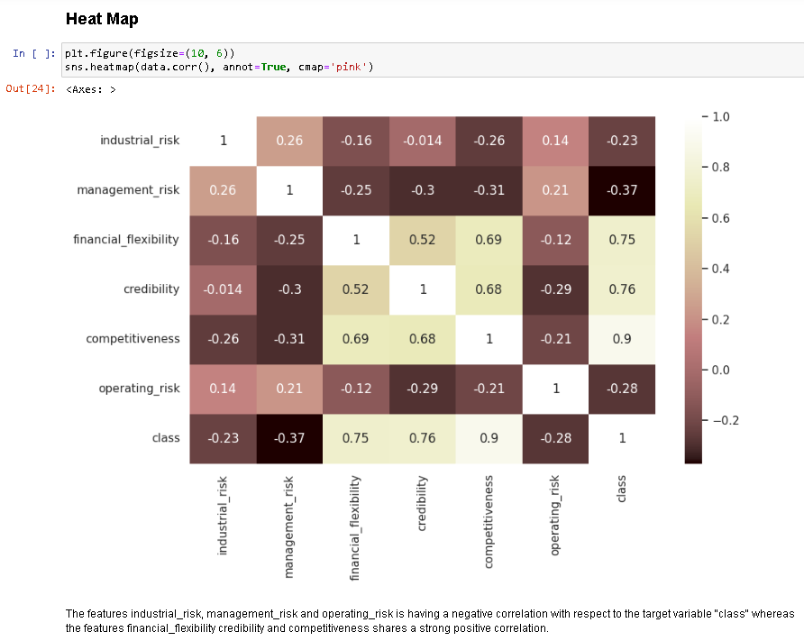
Heat Map Visualization

Slide 14
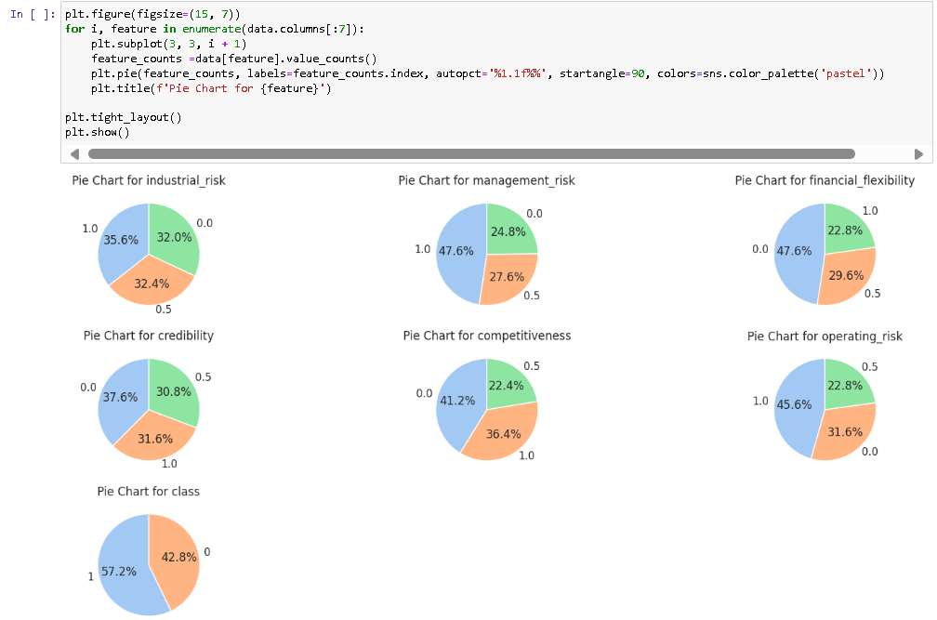
Pie Chart Visualization

Slide 15
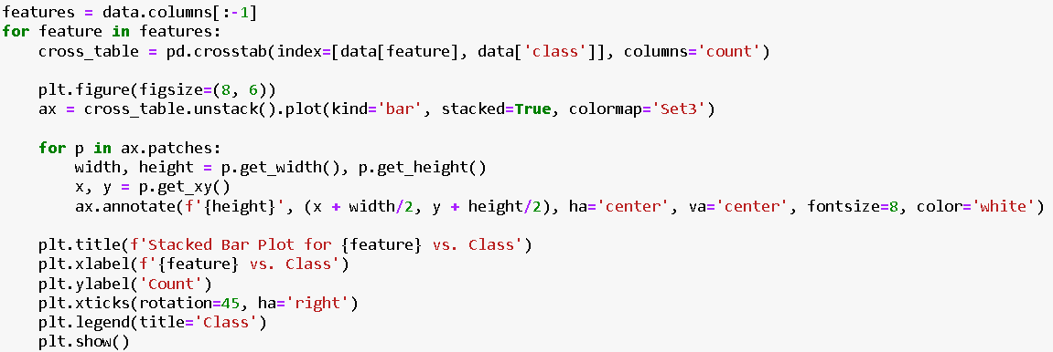
Stacked Area Plot

Slide 16
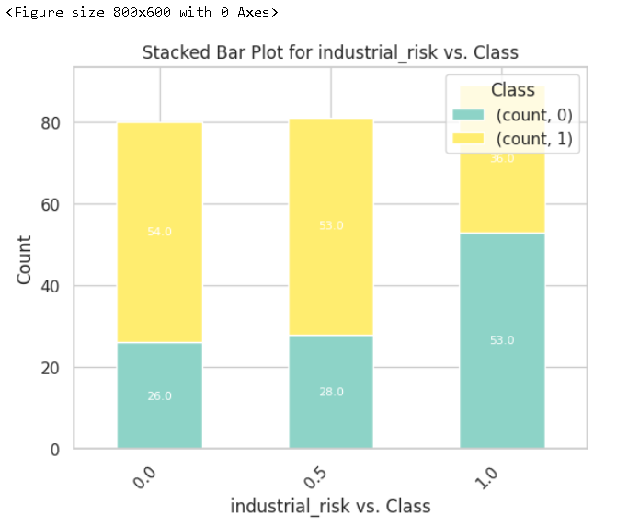
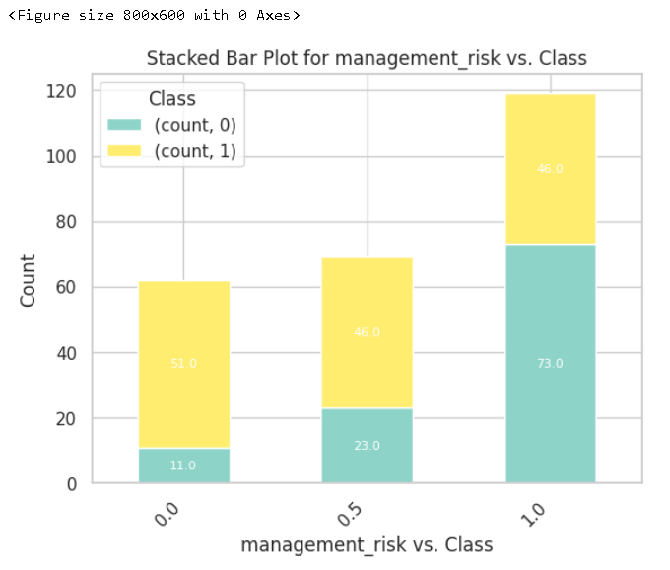
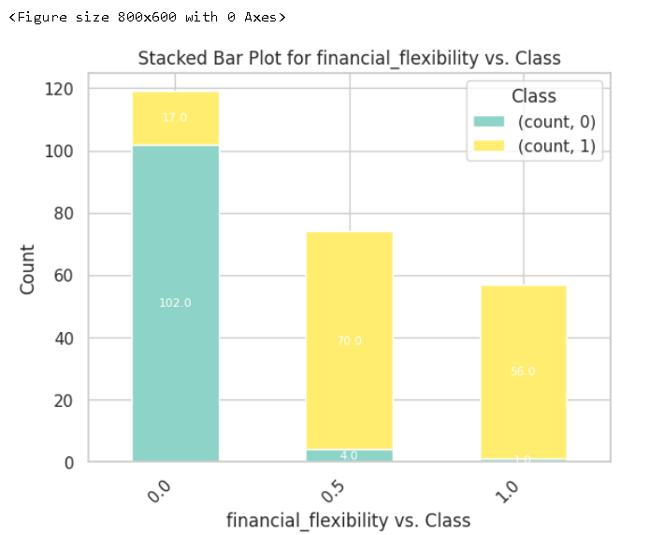
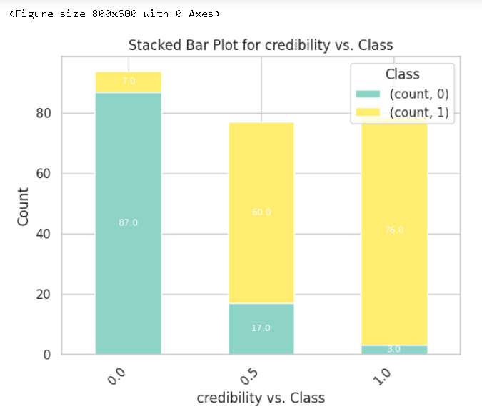
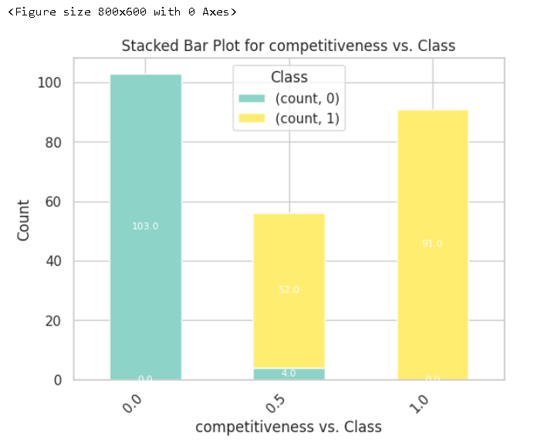
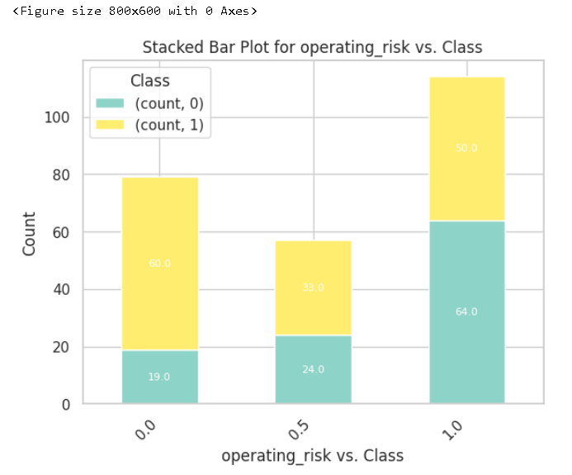

Slide 17
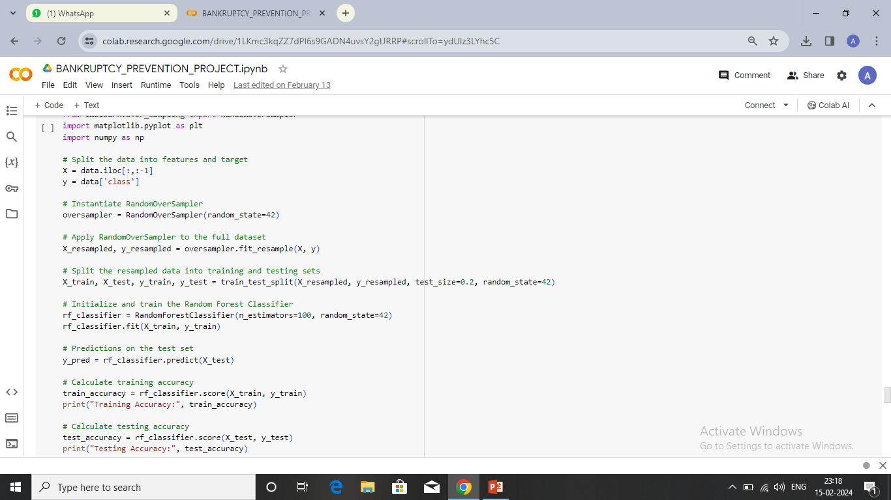
Model Building
Splitting Data
Observation:-
Data Splitting: The code splits the original dataset into features (X) and the target variable (y).
Imbalanced Class Handling: The code employs the RandomOverSampler technique to handle class imbalance in the dataset. This is particularly useful when one or more classes are underrepresented in the dataset, which could lead to biased model training.
Train-Test Split: After resampling, the resampled data is split into training and testing. Where 80% of the data goes for training and the rest 20% for testing.

Slide 18
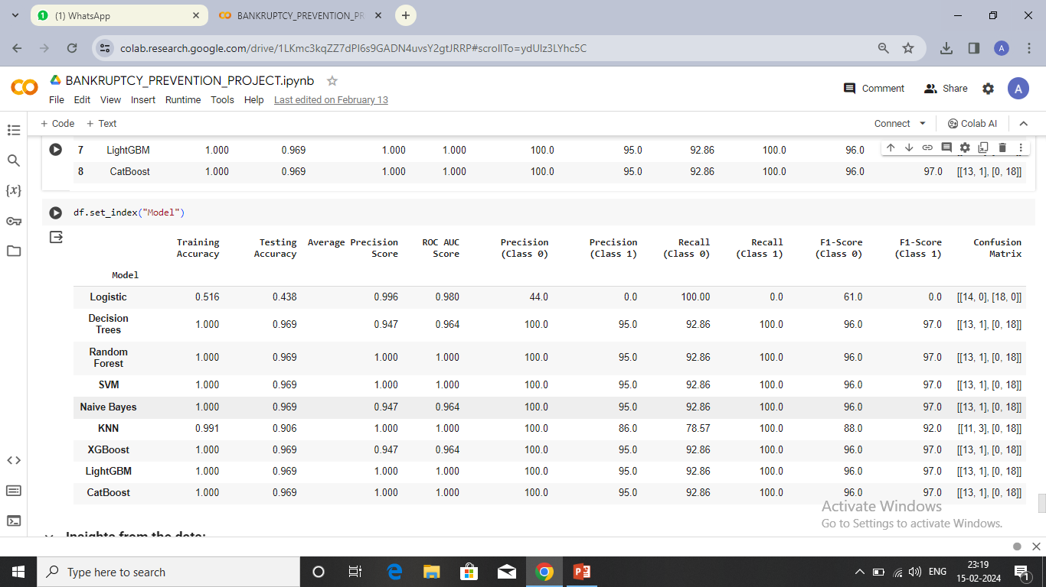
Model Summary
Insights from the Data:-
Models like Decision Trees, Random Forest, SVM, Naive Bayes, XGBoost, LightGBM, and CatBoost demonstrate high testing accuracy, with values around 96.9%.
Decision Trees, Random Forest, SVM, Naive Bayes, XGBoost, LightGBM, and CatBoost have correctly classified most instances for both classes, as evident from their confusion matrices
Random Forest, SVM, Naive Bayes, XGBoost, LightGBM, and CatBoost seem to perform consistently well having higher average precision score and ROC AUC score.
Based on these insights, Random Forest, SVM, LightGBM, and CatBoost can be considered the best models for this particular task, as they consistently perform well across various evaluation metrics.

Slide 19
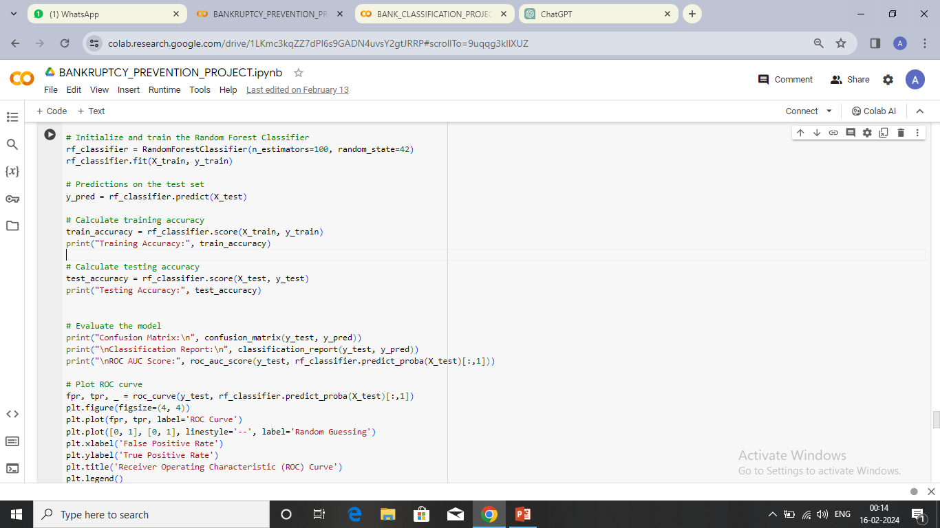
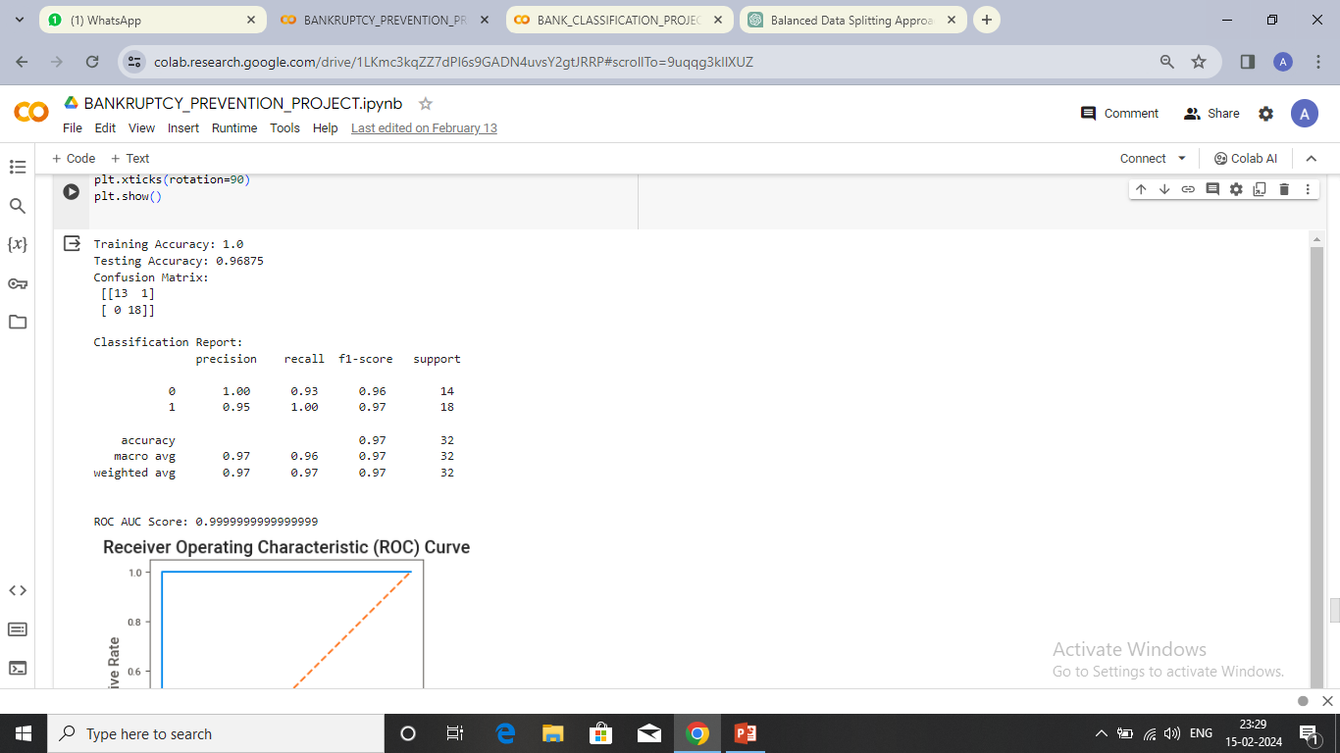
Model Selection
Random Forest
Observation:
Random Forest Classifier Initialization.
Fit the training set of data to that RF model.
Next, test the data and draw conclusions based on the results.
The training accuracy tells us how well it remembers the examples it was taught, and the testing accuracy tells us how well it can predict outcomes for new examples.
We print out the training and testing accuracies to see how good our model is at remembering what it learned and at making new predictions.

Slide 20
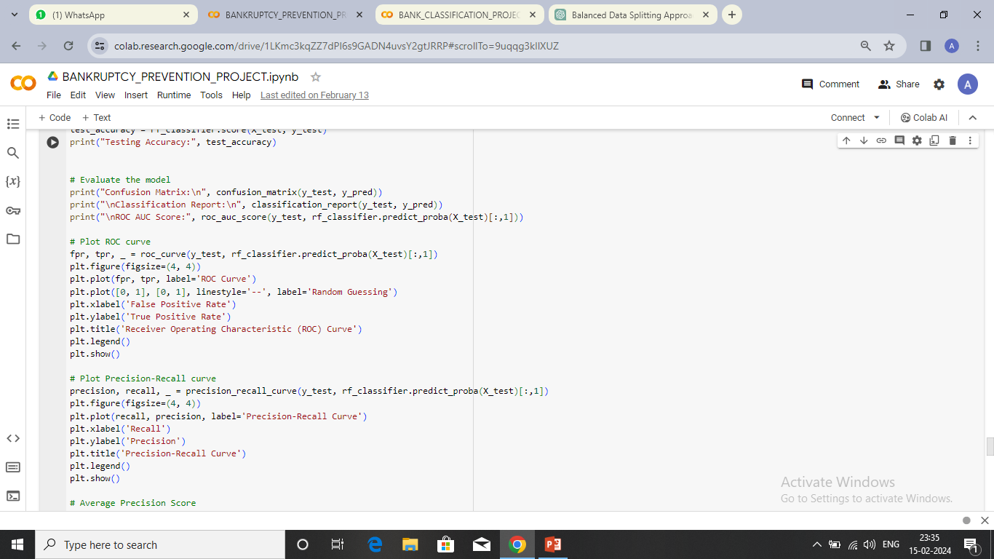

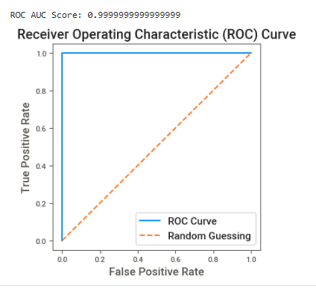
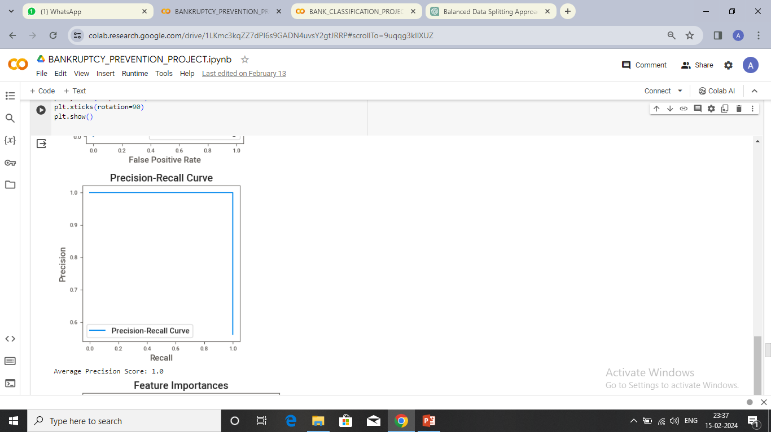
Model Evaluation

Slide 21
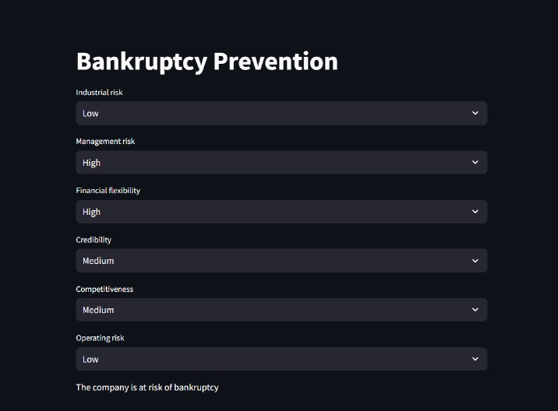
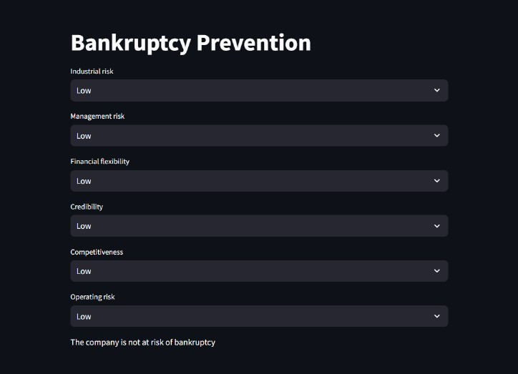
Deployment

Slide 22


